Slide 1

Customer Churn Prediction Analysis
Presented by :
Sumit M. Raut

Slide 2
Objective
The primary goal of this analysis was to predict customer churn and derive actionable insights to improve customer retention and increase sales. The dataset contained customer information, purchasing behavior, and churn indicators, enabling exploratory data analysis (EDA), predictive modeling, and the identification of key trends and patterns.

Slide 3
Dataset Overview
The dataset contains the following fields:
Customer ID: Unique identifier for each customer.
Age: Age of the customer.
Gender: Gender of the customer.
Annual Income: Customer's yearly income.
Spending Score: A metric representing spending habits.
Purchase History: Aggregated count or value of purchases.
Membership Duration: Duration of the customer's membership in years.
Feedback Score: Customer satisfaction rating.
Churn Indicator: Target variable (0 = No, 1 = Yes).

Slide 4
Approach
Performed Exploratory Data Analysis (EDA) to identify trends and anomalies.
Cleaned and preprocessed the data, handling missing values and outliers.
Engineered features to improve model performance.
Trained and compared multiple models: Logistic Regression, Random Forest, and XGBoost.
Evaluated models using metrics like accuracy, precision, recall, and F1-score.

Slide 5
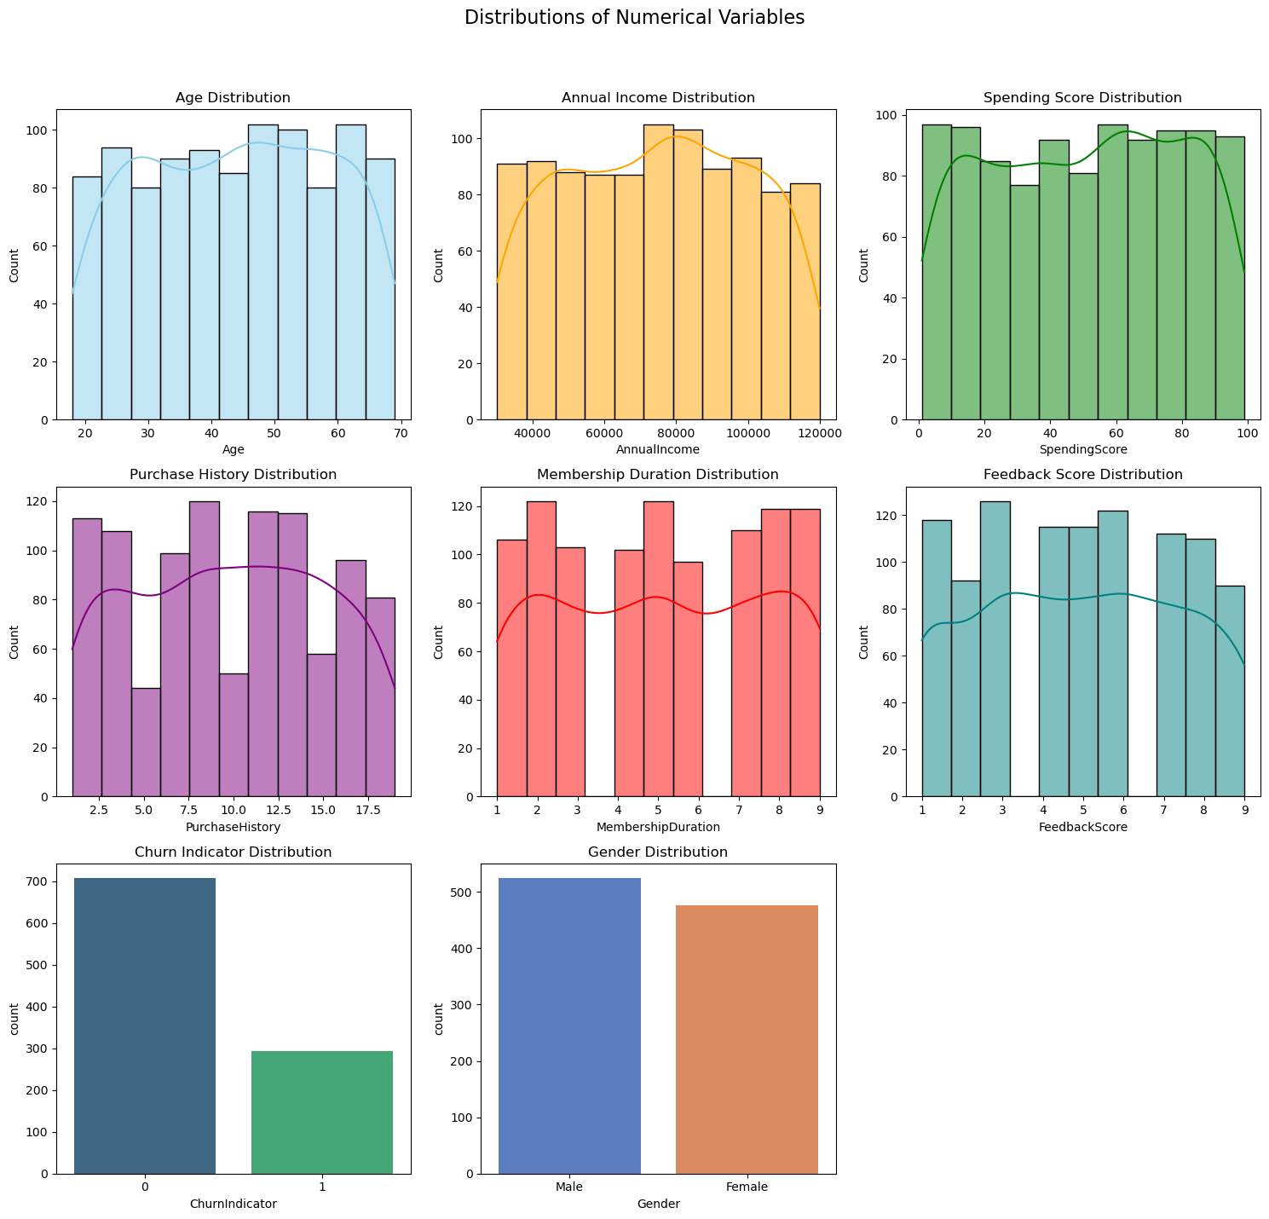

Slide 6
Key Insights from Visualizations:
Age Distribution: Most customers fall between the ages of 30 and 60, with a slight peak around 45.
Annual Income: A wide range of incomes, with a majority clustering between 50,000 and 100,000.
Spending Score: Nearly uniform distribution with a slight peak around 50, indicating diverse spending behaviors.
Purchase History: Most customers have 5-15 purchases, with fewer at the extremes.
Membership Duration: Skewed towards shorter durations, with a peak at around 5 years.
Feedback Score: Most customers rate their experience moderately (scores between 3 and 7).
Churn Indicator: About 70.7% of customers have not churned (Churn Indicator = 0), 29.3% have churned (Churn Indicator = 1).
Gender Distribution: The dataset is relatively balanced: 52.4% Male and 47.6% Female..

Slide 7
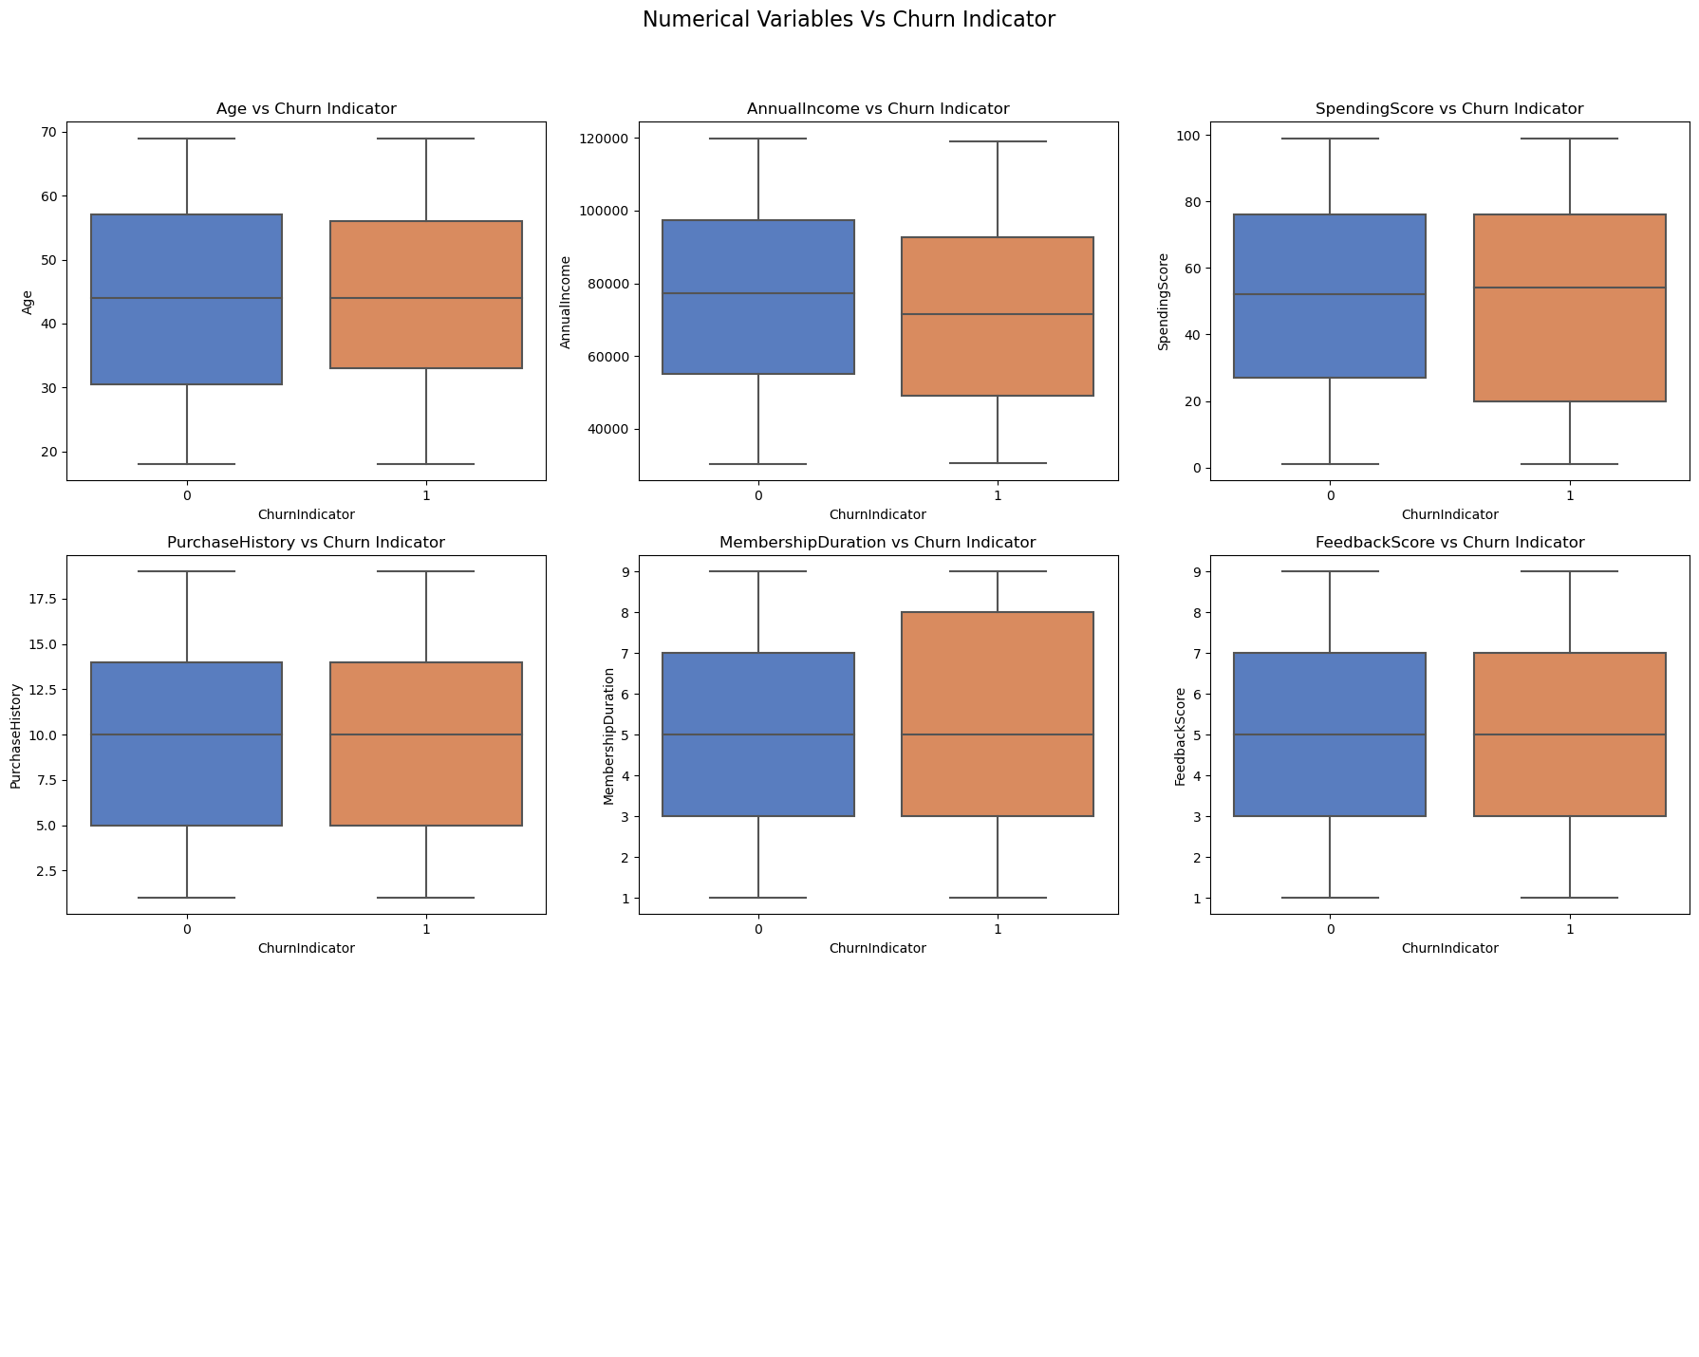
Relationship between churn and numerical variables using boxplots

Slide 8
Insights from the Visualizations:
Age vs Churn: The age distribution does not show a strong difference between churned and retained customers, but younger customers might have slightly higher churn rates.
Annual Income vs Churn: Customers with lower or mid-range annual incomes appear more likely to churn compared to those with higher incomes.
Spending Score vs Churn: Churned customers tend to have slightly lower spending scores compared to retained ones.
Purchase History vs Churn: Customers with fewer past purchases are more likely to churn, while those with higher purchase history are predominantly retained.
Membership Duration vs Churn: Shorter membership durations correlate strongly with churn. Retained customers have longer memberships on average.
Feedback Score vs Churn: Lower feedback scores are associated with higher churn rates, indicating dissatisfaction might play a role in customer churn.

Slide 9
Key Insights
Top Predictors of Churn:
Membership Duration: Customers with shorter memberships are more likely to churn. Engaging new customers quickly is crucial.
Feedback Score: Low feedback scores strongly correlate with higher churn risk. Dissatisfaction drives customer attrition.
Spending Intensity: Customers who spend less frequently compared to their membership duration are at higher risk of churning.
Income-to-Spending Ratio: High ratios may indicate customers who are cautious spenders and less engaged.

Slide 10
Key Insights
High-Churn Segments:
Younger Customers (18-25 age group): Tend to have higher churn rates due to potentially lower loyalty or shifting needs.
Low-Income Customers: May feel less incentivized to maintain memberships if perceived value is insufficient.
Customers with Low Feedback and Purchase History: Reflect dissatisfaction or disengagement.

Slide 11
Recommendations to Increase Sales
Personalized Marketing Campaigns: Leverage insights from the model to create tailored campaigns targeting specific segments (e.g., low-feedback customers with special offers).
Cross-Selling and Upselling: Use purchase history data to recommend complementary products or services.
Loyalty Programs: Introduce reward points for purchases, referrals, and feedback submissions to enhance engagement.
Predictive Churn Interventions: Deploy churn predictions to trigger automated retention offers (e.g., discounts, free trials) before high-risk customers leave.

Slide 12
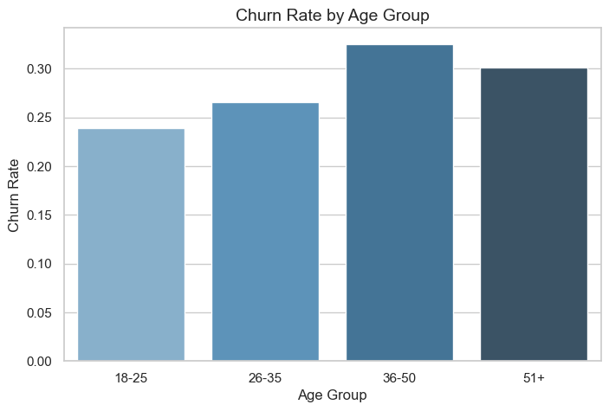
Visualizations that effectively communicate Key insights
Churn Rates across Age Groups (e.g., 18-25, 26-35, etc.).

Slide 13
Insights
Younger age groups (e.g., 18-25) may exhibit higher churn rates, indicating a potential lack of loyalty or engagement within this demographic.
Older age groups might have lower churn rates, reflecting higher loyalty and satisfaction with services or products.
Actionable Recommendation: Create targeted retention programs for younger customers, such as gamified loyalty rewards, exclusive events, or discounts tailored to their preferences.

Slide 14
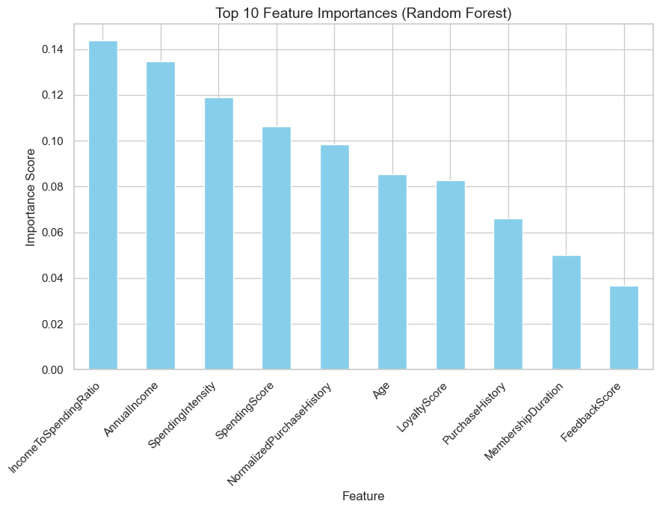
Top 10 Feature Importances (Random Forest)

Slide 15
Insights
Membership Duration and Feedback Score are likely to rank as the most significant predictors of churn.
Features like Spending Score, Income-to-Spending Ratio, or Normalized Purchase History might also rank high, offering actionable insights into customer engagement and financial behavior.
Actionable Recommendation
For customers with short memberships, improve onboarding and engagement during the critical early stages.
Address dissatisfaction by analyzing low feedback scores and resolving customer concerns promptly.

Slide 16
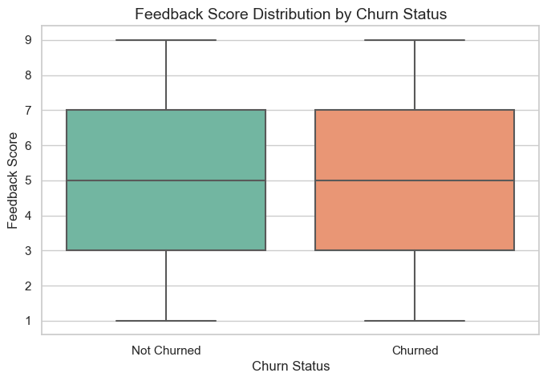
Distribution of feedback scores for churned vs. non-churned customers.

Slide 17
Insights
Churned customers might have significantly lower feedback scores than non-churned customers, indicating dissatisfaction as a key churn driver.
Non-churned customers likely have consistently higher feedback scores, reflecting satisfaction and engagement.
Actionable Recommendation
Conduct surveys or exit interviews to identify common pain points for churned customers.
Develop loyalty programs or perks to incentivize high feedback scores, further boosting retention.

Slide 18
Next Steps
Implement targeted retention campaigns based on churn predictions.
Monitor feedback continuously and act on customer concerns promptly.
Explore additional features and alternative modeling techniques for improvement.

Slide 19
Thank You

